Slide 1
State-Transition Testing
Example in
Reservation system

Slide 2
State-Transition Testing Example
State-Transition diagrams are an excellent tool to capture certain types of system requirements and to document internal system design.
These diagrams document the events that come into and are processed by a system as well as the system's responses.

Slide 3
Reservation system example
1- Make a reservation
Provide information including departure and destination cities, dates, and times.
A reservation agent uses that information to make a reservation.
At that point, the Reservation is in the Made state.
The system creates and starts a timer.
If this timer expires before the reservation is paid for, the reservation is cancelled by the system.

Slide 4
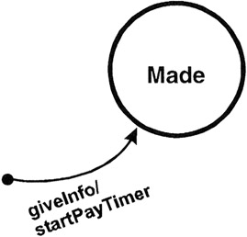
The Reservation is Made
giveInfo, is an event that comes into the system from the outside world.
The command after the "/" denotes an action of the system; in this case startPayTimer.

Slide 5
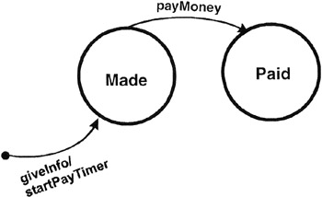
2- Pay for the Reservation - PayMoney
The Reservation transitions to the Paid state.
Events may have parameters associated with them. For example, Pay Money may indicate Cash, Check, Debit Card, or Credit Card

Slide 6
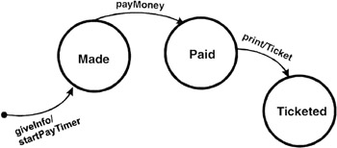
3- Print the ticket: - print
The Reservation transitions to the Ticketed state.

Slide 7
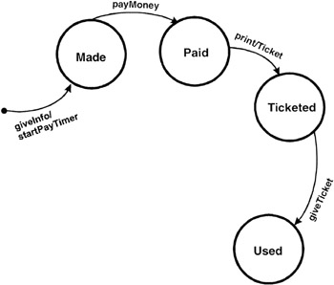
4- Give ticket
giveTicket to the gate agent to board the plane
The Reservation transitions to the Used state.

Slide 8
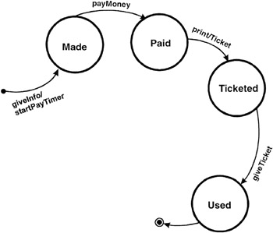
4- Give ticket (Cont.)
The path ends

Slide 9
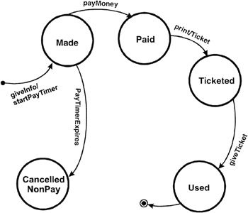
5- Cancel for no payment by the ‘PayTimer’
If the Reservation is not paid the PayTimer expires and the Reservation is cancelled for non-payment.

Slide 10
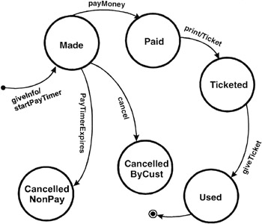
6- Cancel by customer
When the customer asks to cancel the Reservation
Cancel the Reservation from the Made state

Slide 11
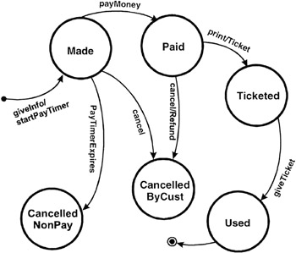
7- Cancel by customer after payment
A Reservation is cancelled from the Paid state, a Refund should be generated and leave the system
Cancellation from the Paid state

Slide 12
8- Customer cancels after receiving the ticket
From the Ticketed state, the customer can cancel the Reservation.
In that case a Refund should be generated.
The airline will generate a refund but only when it receives the printed Ticket from the customer.
  This introduces one new notational element—square brackets [....] that contain a conditional that can be evaluated either True or False.
This conditional acts as a guard allowing the transition only if the condition is true.

Slide 13
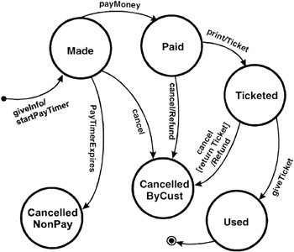
8- Customer cancels after receiving the ticket (cont.)
Cancellation from the Ticketed state

Slide 14
State-Transition Tables
➔ Creating Test Cases
State-transition tables may be easier to use in a complete and systematic manner.
State-transition tables consist of four columns ➔ Current State, Event, Action, and Next State.

Slide 15
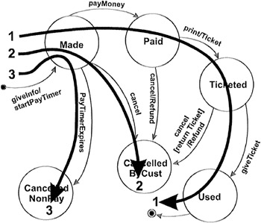
Creating Test Cases
Create a set of test cases such that all states are "visited" at least once under test.
The set of three test cases shown below meets this requirement. Generally this is a weak level of test coverage.
A set of test cases that "visit" each state

Slide 16
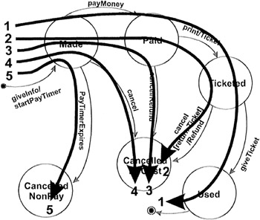
A set of test cases that trigger all transitions at least once
Create a set of test cases such that all transitions are exercised at least once under test.
  This level of testing provides a good level of coverage without generating large numbers of tests.
  This level is generally the one recommended.

Slide 17
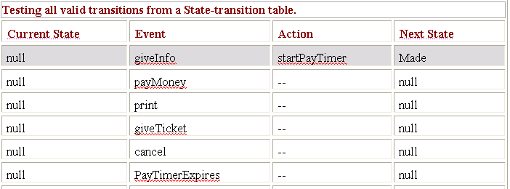
4. A set of test cases that trigger all transitions at least once (Cont.)
Test cases can also be read directly from the state-transition table.
The gray rows in the following table show all the valid transitions.

Slide 18
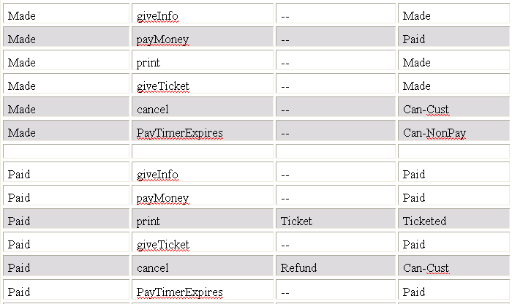

Slide 19
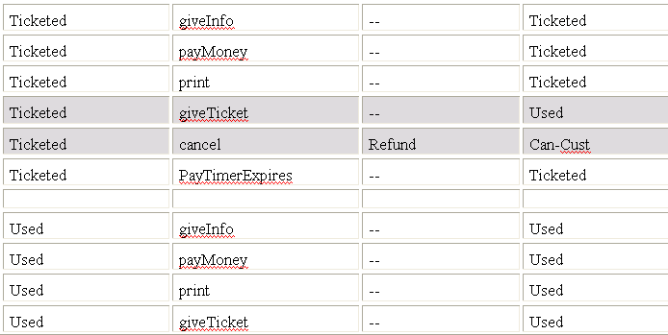


Slide 20
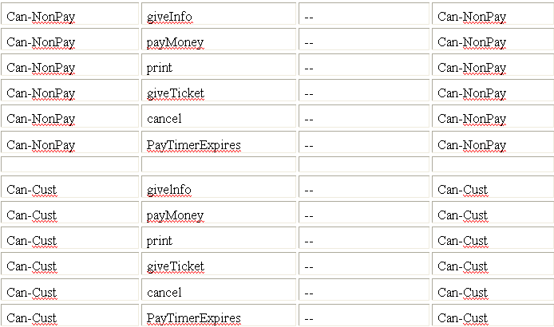

Slide 21
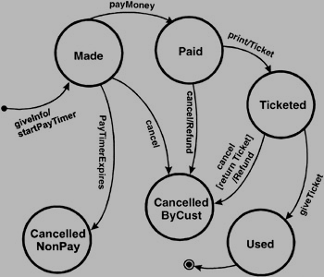
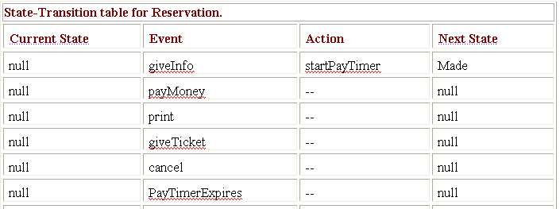
Kelas “Reservation”

Slide 22
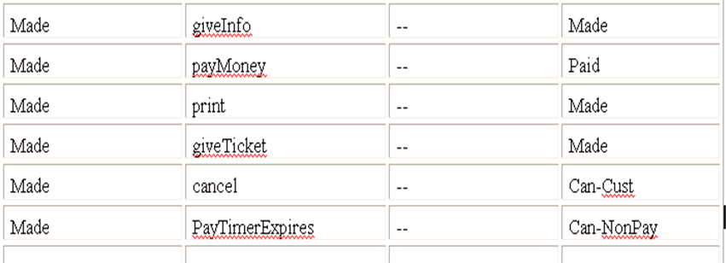
Kelas “Made”

Slide 23
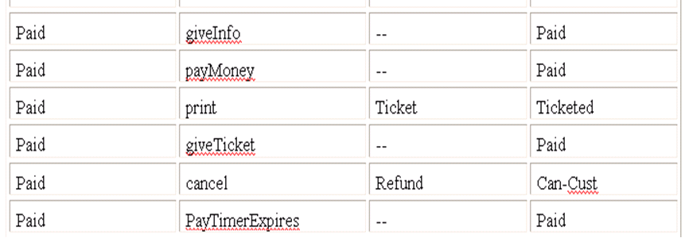
Kelas “Paid”

Slide 24
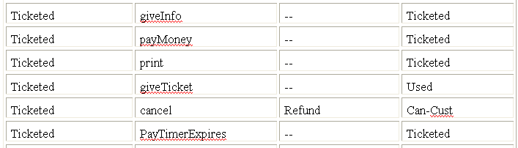
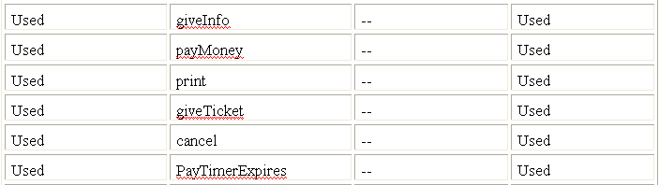

Slide 25
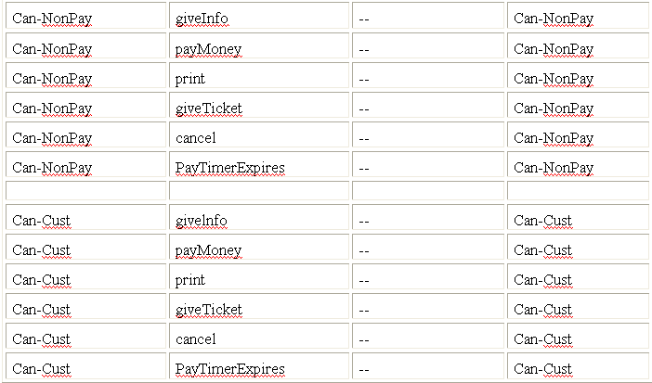

Slide 26
State-Transition Testing (Cont.)
Summary
State-Transition diagrams efforts by identifying the states, events, actions, and transitions .
These define how a system interacts with the outside world, the events it processes, and the valid and invalid order of these events.
The generally recommended level of testing using state-transition diagrams is to create a set of test cases such that all transitions are exercised at least once under test.
In high-risk systems, you may want to create even more test cases, approaching all paths if possible or create test cases for some or all of the invalid state/event pairs to make sure the system has not implemented invalid paths.

Slide 27
State-Transition Tables (Cont.)
The advantage of a state-transition table is that it lists all possible state-transition combinations, not just the valid ones.
When testing critical, high-risk systems such as avionics or medical devices, testing every state-transition pair may be required, including those that are not valid.
Creating a state-transition table often unearths combinations that were not identified, documented, or dealt with in the requirements. It is highly beneficial to discover these defects before coding begins.

Slide 28
State-Transition Tables (Cont.)
Using a state-transition table can help detect defects in implementation that enable invalid paths from one state to another.
The disadvantage of such tables is that they become very large very quickly as the number of states and events increases.
In addition, the tables are generally sparse; that is, most of the cells are empty.

